Slide 1
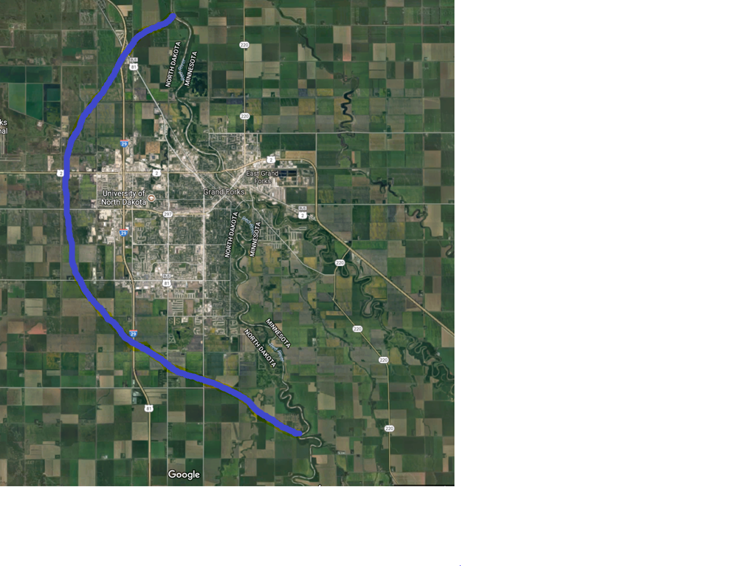

Slide 2
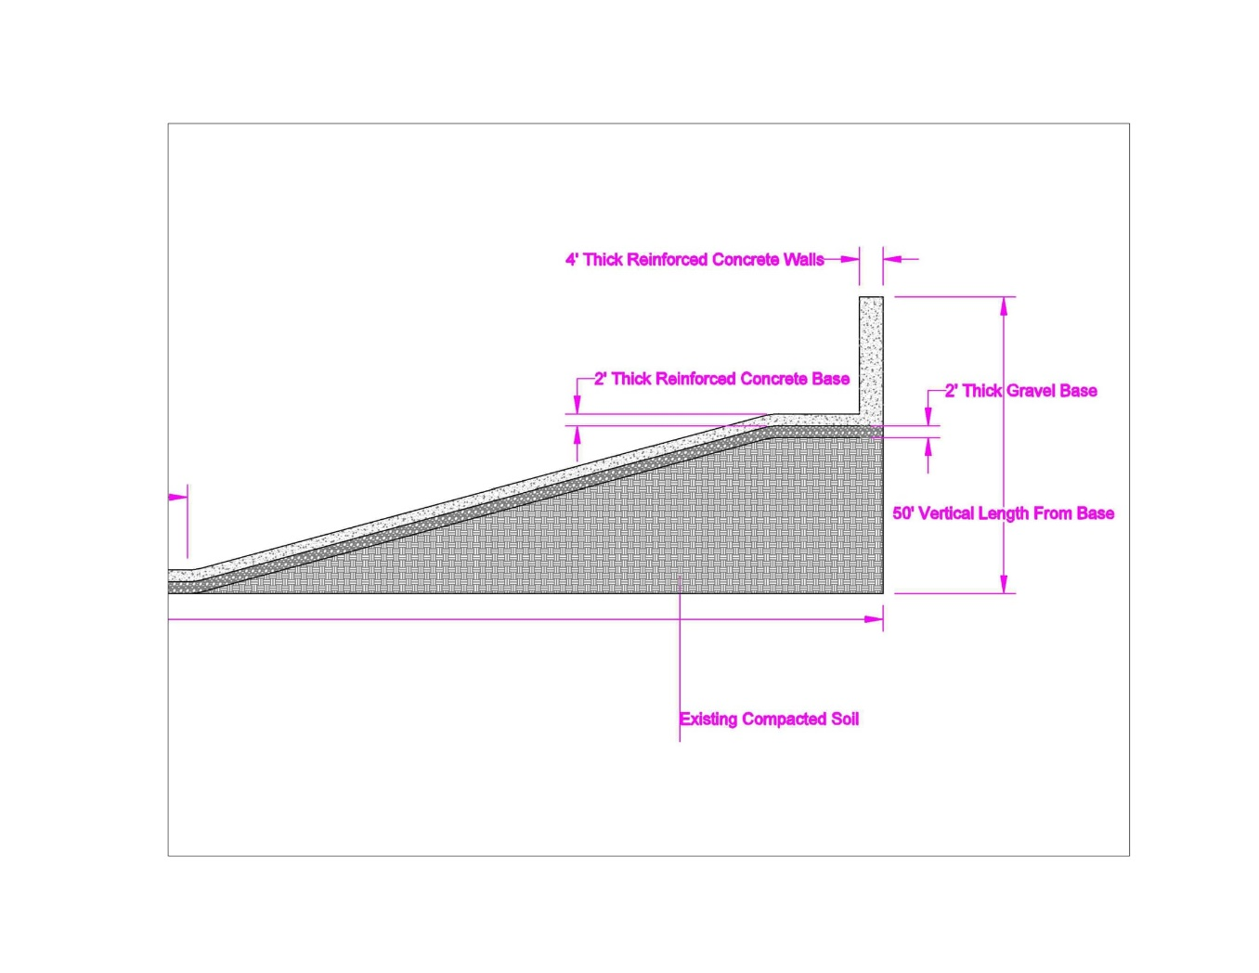
2D Cross Section of Slope of Water Diversion Channel

Slide 3
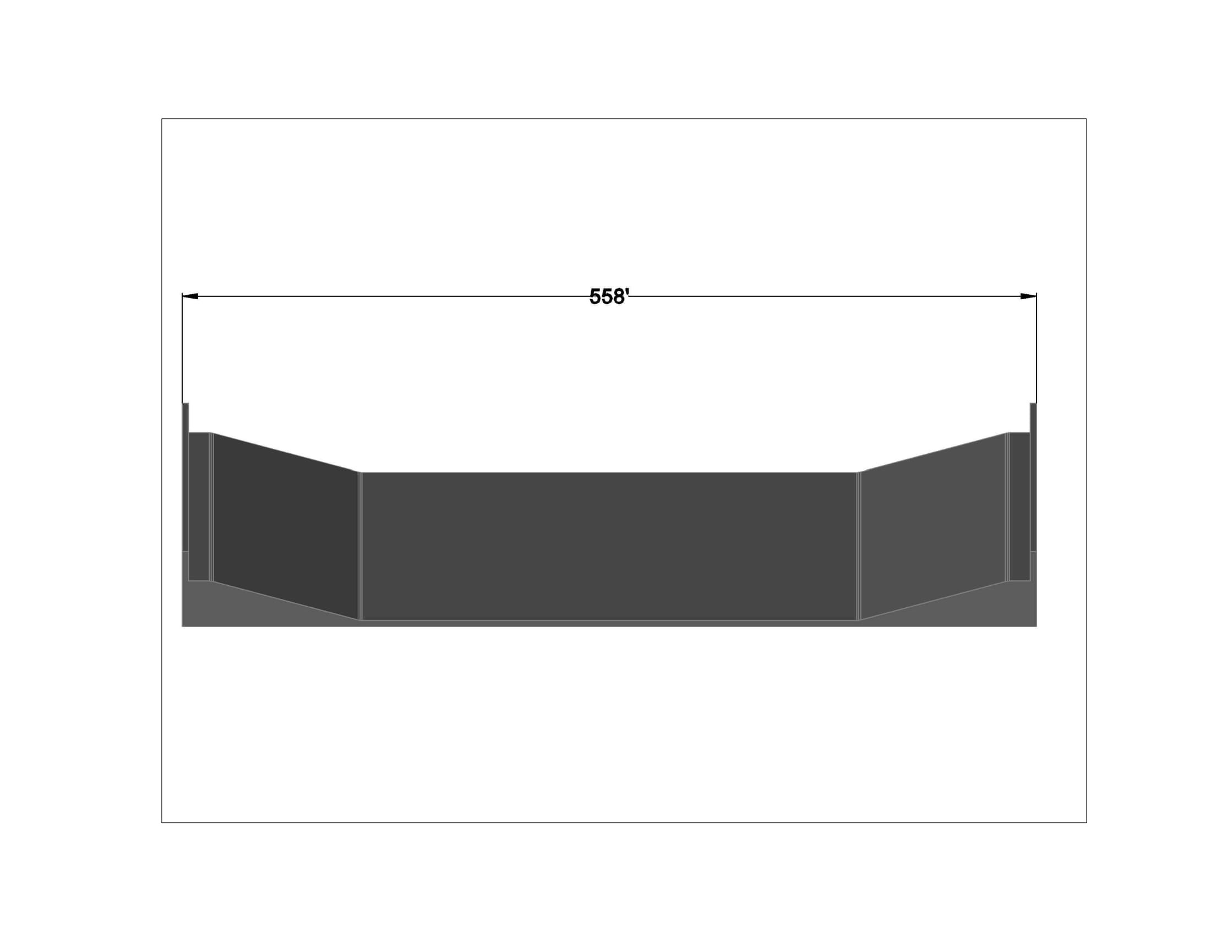
3D Model of 500' long Section of Water Diversion Channel

Slide 4
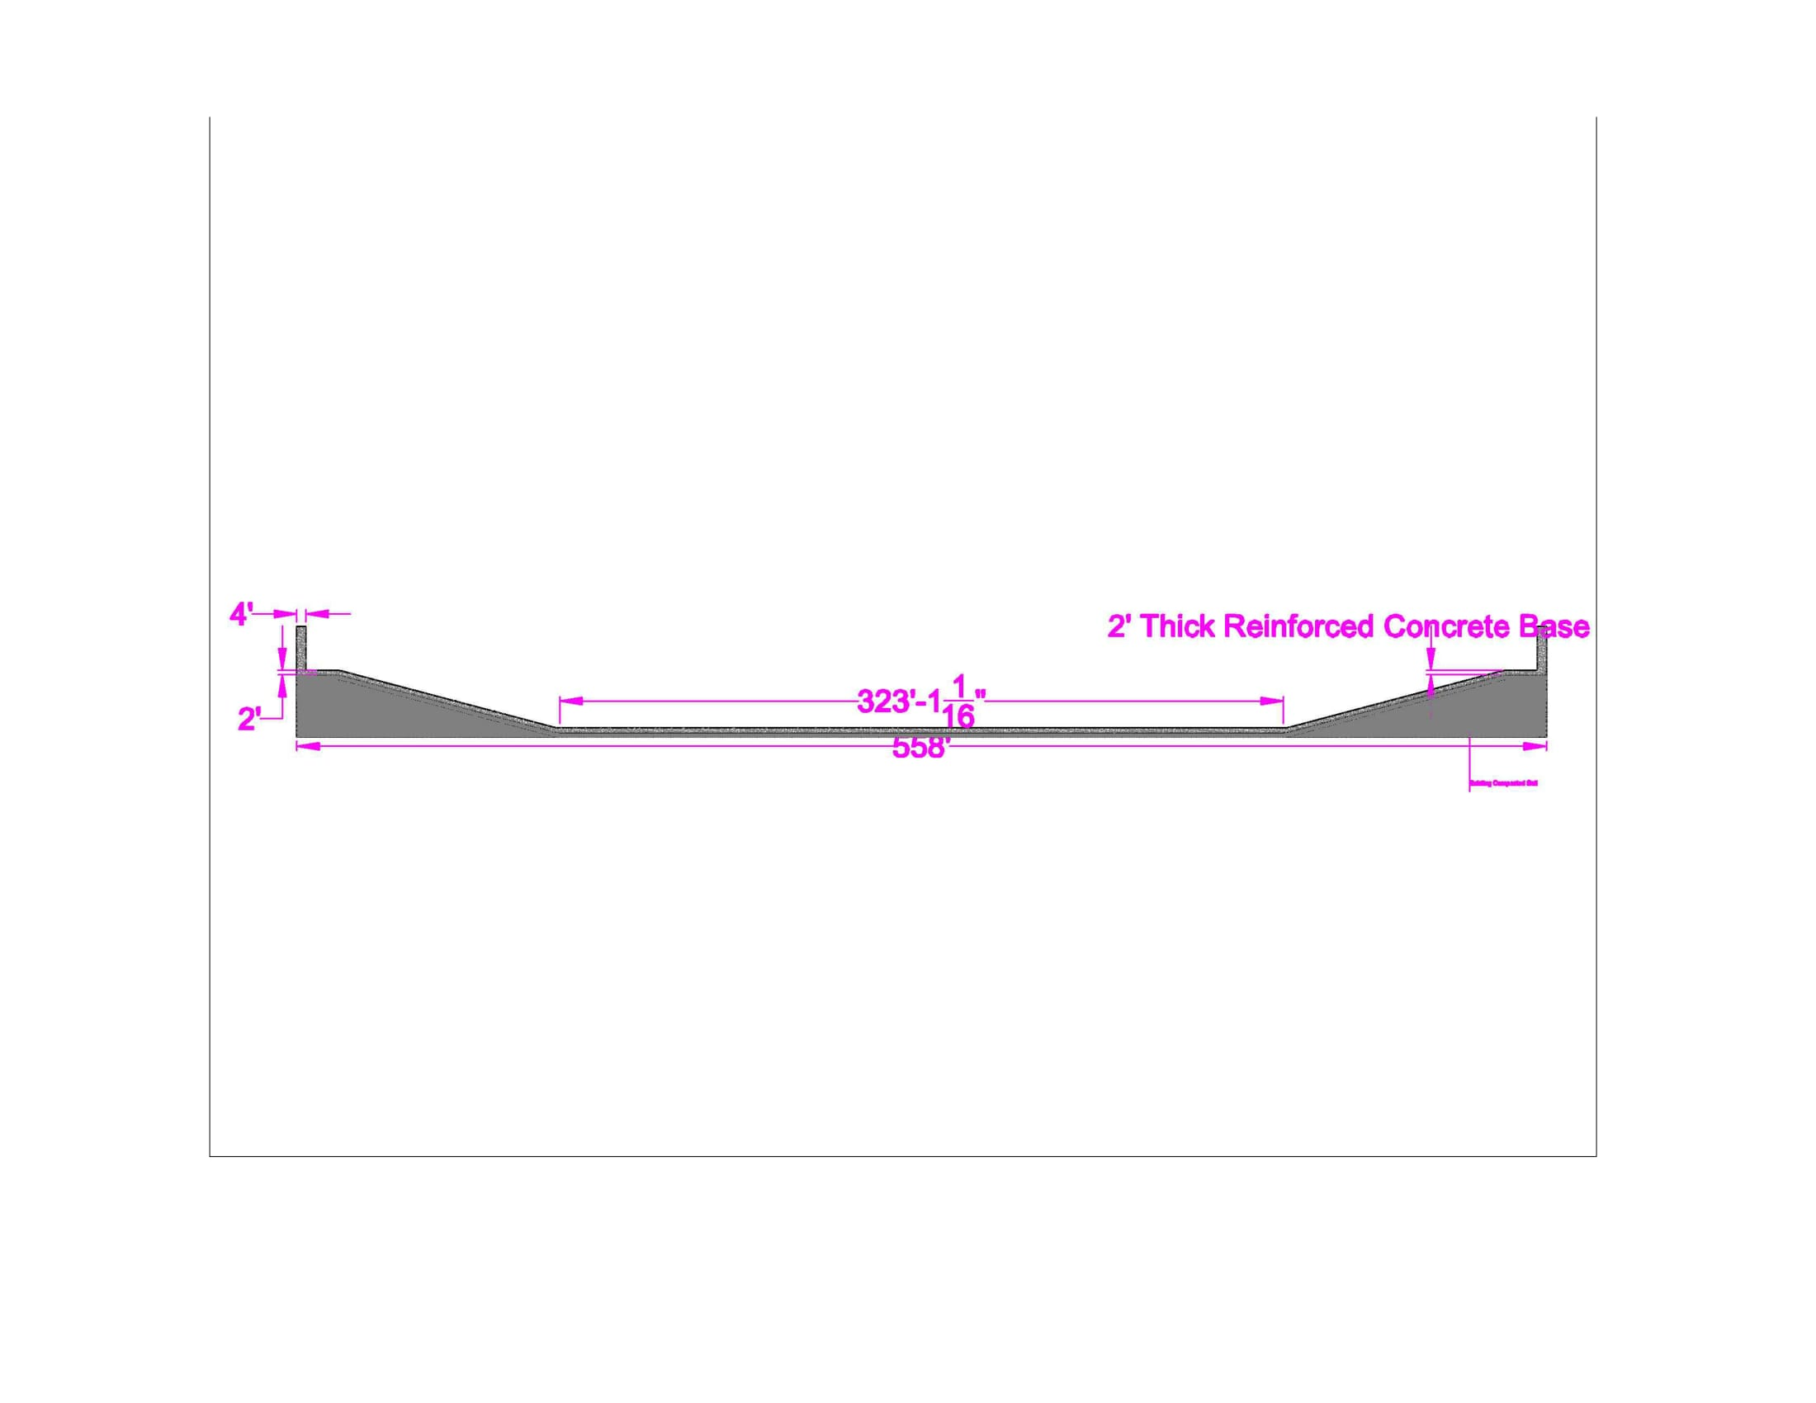
2D Cross Section of Water Diversion Channel

